Slide 1
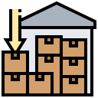
Inventory Control Management
Ibrahim Abou Zahr – Omar Takkoush

Slide 2

DBMS Purpose
Inventory Management: This database efficiently tracks and manages inventory levels for various products.
Supplier Relationship: It facilitates the maintenance of supplier information and helps in managing supplier relationships.
Customer Service: It enables effective customer service by storing customer details and order history, facilitating personalized interaction
Order Fulfillment: The system assists in processing orders, tracking their status, and managing customer information.

Slide 3
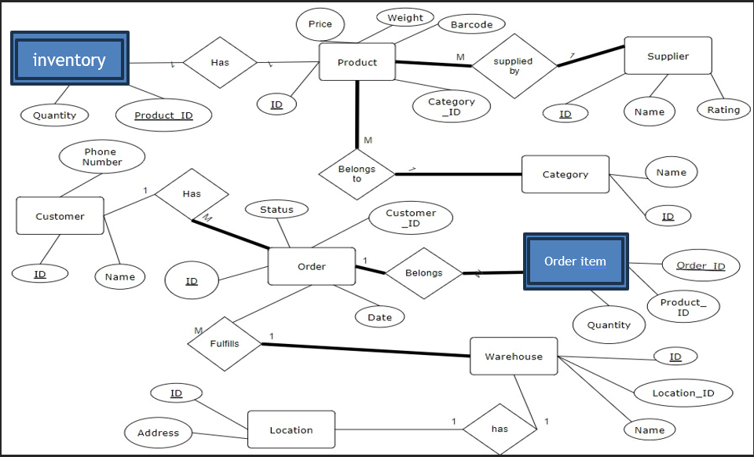
ER Diagram

Slide 4
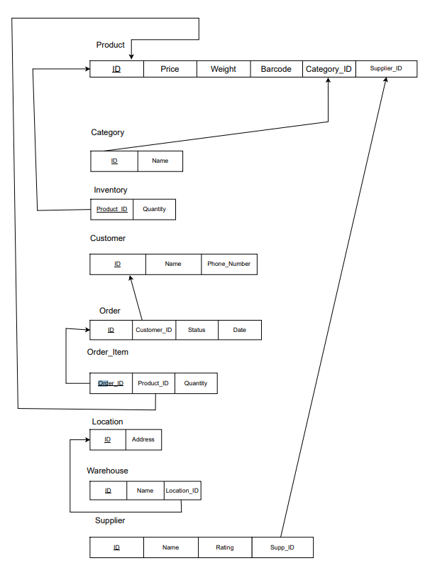
Relational Table
Product - category_ID: - > Category
Inventory - Product_ID: - > Product
Order - customer_ID: - > Customer
Order_item - Order_ID: - > Order Table
Order_item - product_ID: -> Product
Warehouse - location_ID: -> Location

Slide 5

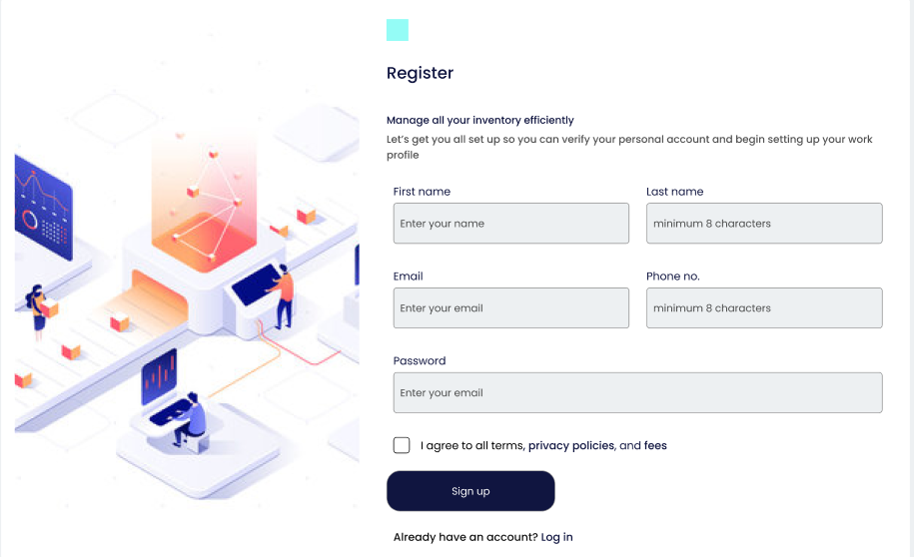
UI Prototype
Login and Register Pages:

Slide 6
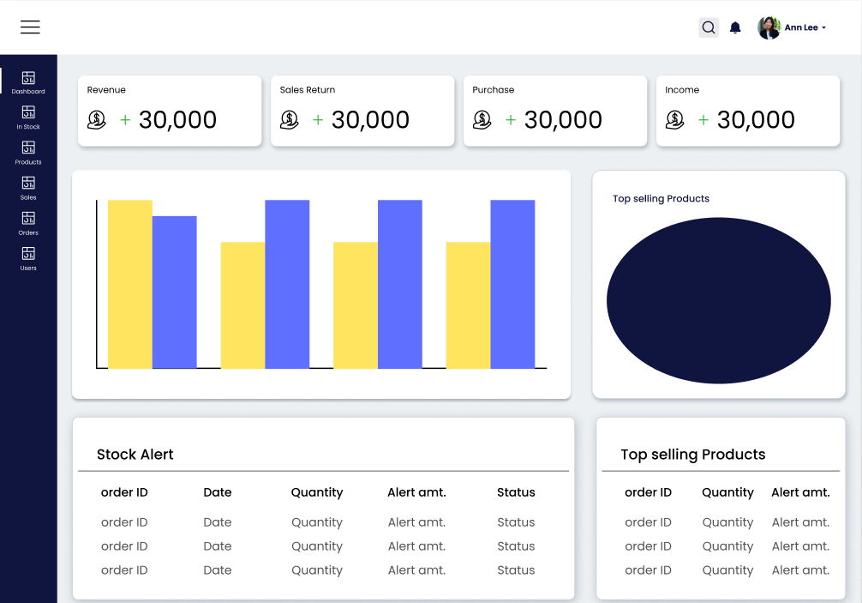
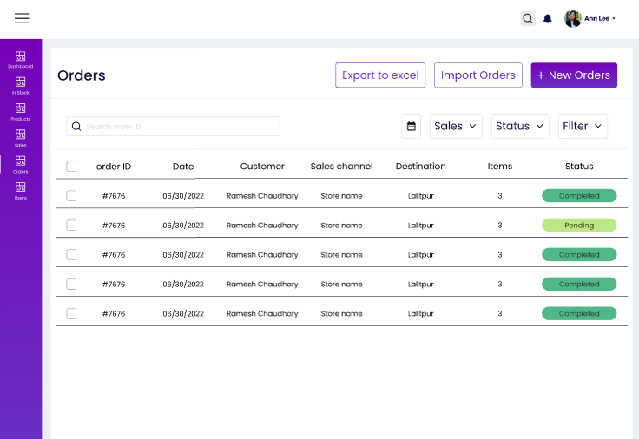
UI Prototype Pt2
Dashboard & Orders:

Slide 7
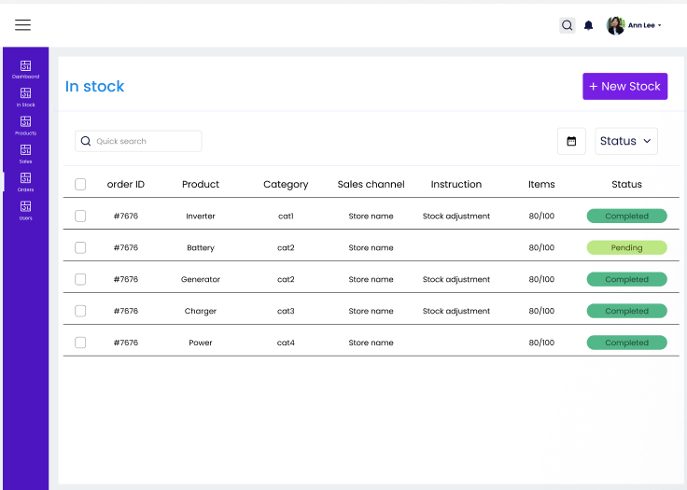
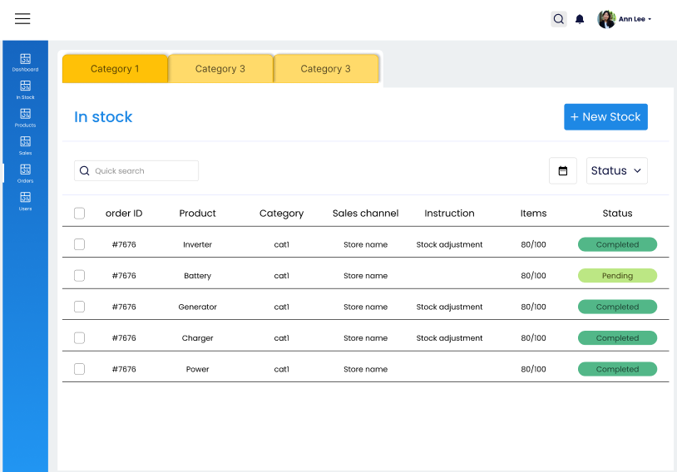
UI Prototype Pt3
Stock:

Slide 8
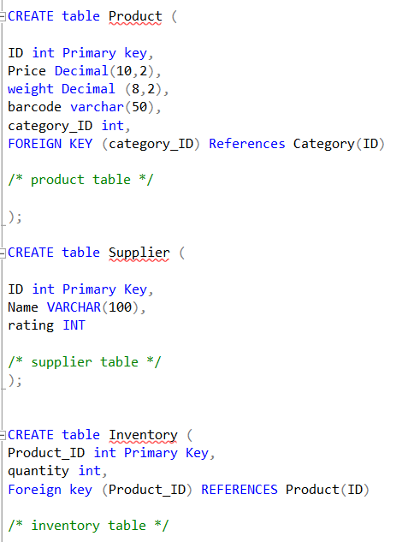
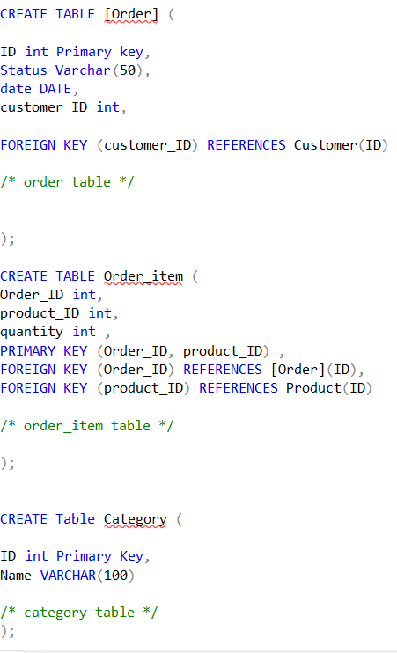
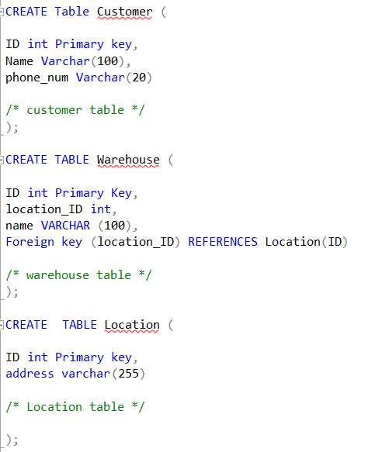
Queries
Creating the tables:

Slide 9
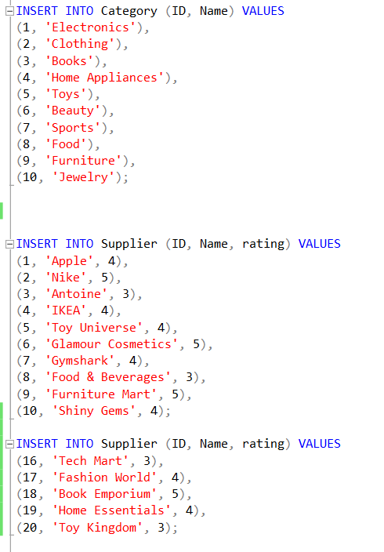
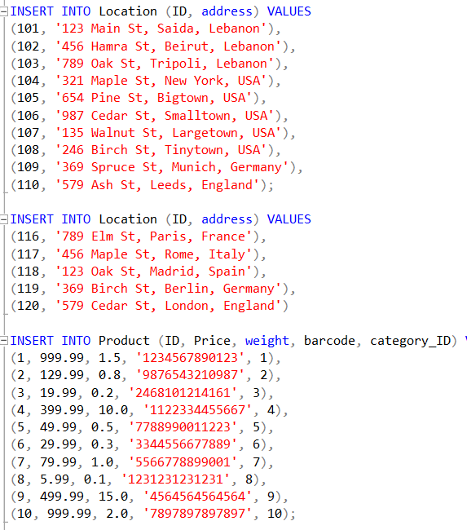
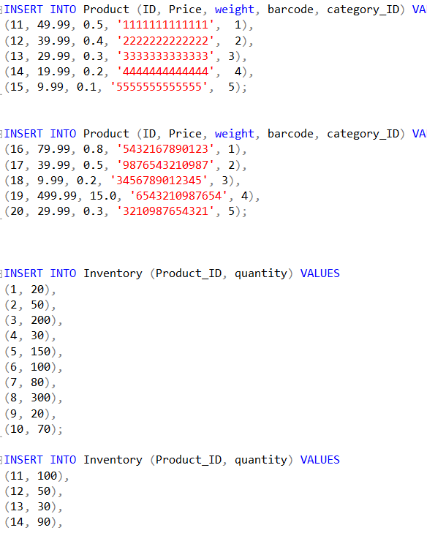
Queries Pt 2
Inserting Values:

Slide 10

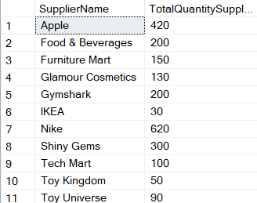

Queries Pt3
Questions that the Inventory Control System answers:
Q1: Which year had the highest sales?
Q2: Who are the top suppliers based on the quantity of products supplied?

Slide 11
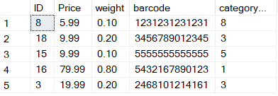
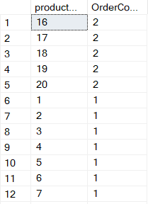
Queries Pt4
Q3: What are the top 5 products with the highest quantity in stock?
Q4: What are the most commonly ordered products?

Slide 12


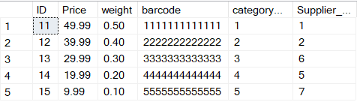
Queries Pt5
Q5: Retrieve customer information based on their ID or name:
Q6: How many orders contain products with a price higher than $100?
Q7: Which products have never been ordered?

Slide 13


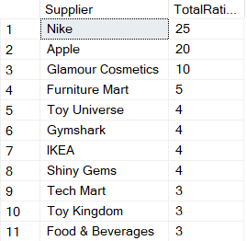
Queries Pt6
Q8: What is the total weight of all products in stock?
Q9: Which suppliers have the highest total ratings?

Slide 14
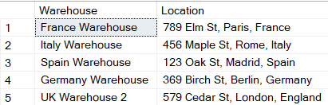


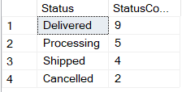

Queries Pt7
Q10: Which warehouses are located in a specific city or country?
Q11: What are the most popular delivery statuses?
Q12: Retrieve all orders that have been cancelled:

Slide 15
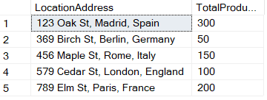
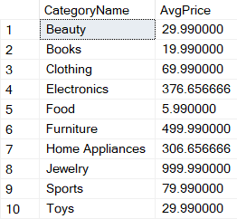

Queries Pt8
Q13: Total number of products in each location:
Q14: Average price of products in each category:

Slide 16
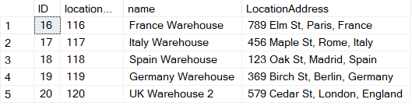
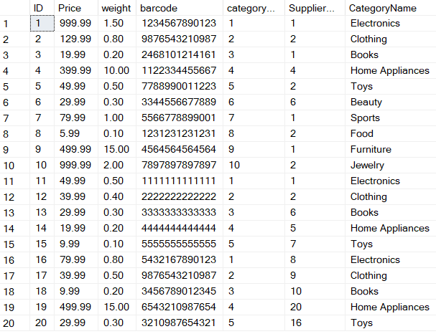
Queries Pt9
Q15: Retrieve all warehouse information along with their respective locations:
Q16: Retrieve all product information along with their respective categories:

Slide 17


Conclusion
This DBMS streamlines retail operations by managing inventory, orders, and suppliers effectively. It maintains relational data integrity through foreign keys, ensuring coherence across tables. With a focus on products, suppliers, customers, orders, and warehouses, it offers a cohesive solution for retail management.

